Slide 1


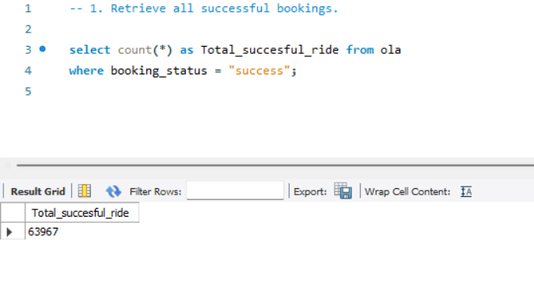

1. Retrieve all successful bookings
SQL Queries

Slide 2
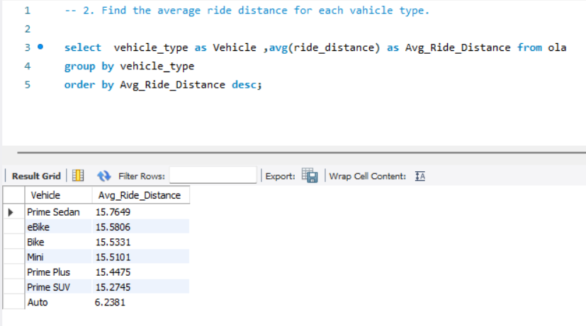
2. Find the average ride distance for each vehicle type
SQL Queries

Slide 3
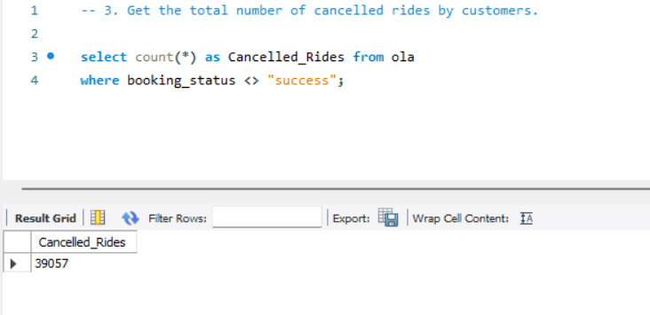
3. Get the total number of cancelled rides by customers
SQL Queries

Slide 4
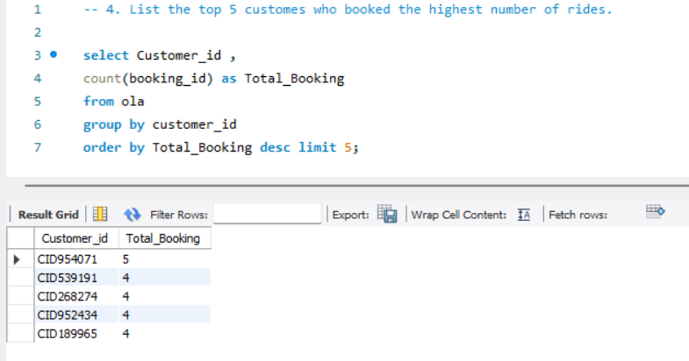
4. List the top 5 customers who booked the highest number of rides
SQL Queries

Slide 5
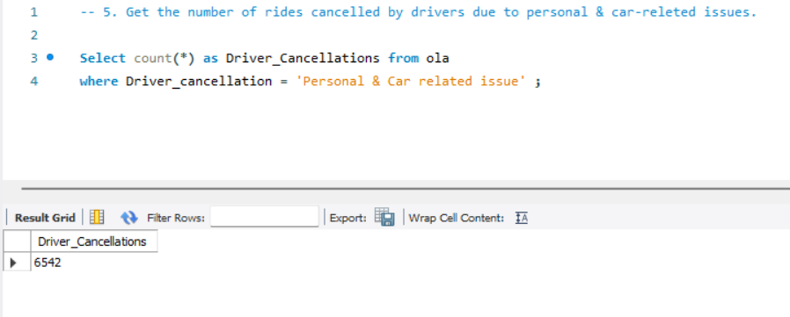
5. Get the number of rides cancelled by drivers due to personal and car-related issues
SQL Queries

Slide 6
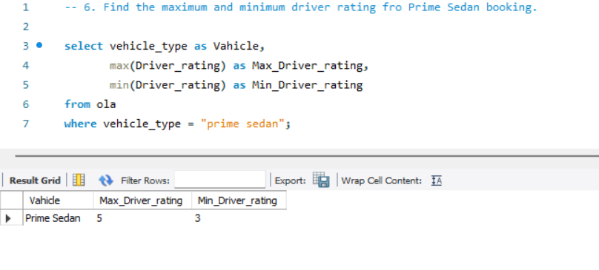
6. Find the maximum and minimum driver ratings for Prime Sedan bookings
SQL Queries

Slide 7
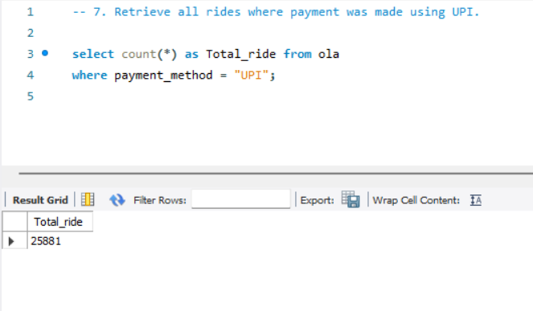
7. Retrieve all rides where payment was made using UPI
SQL Queries

Slide 8
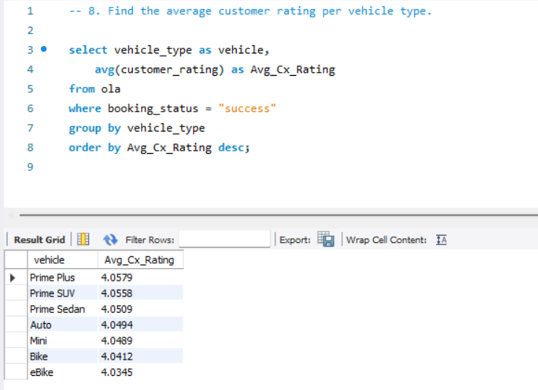
8. Find the average customer rating per vehicle type
SQL Queries

Slide 9
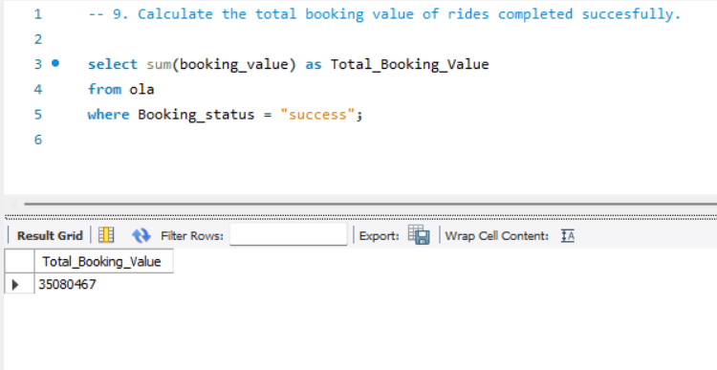
9. Calculate the total booking value of rides completed successfully
SQL Queries

Slide 10
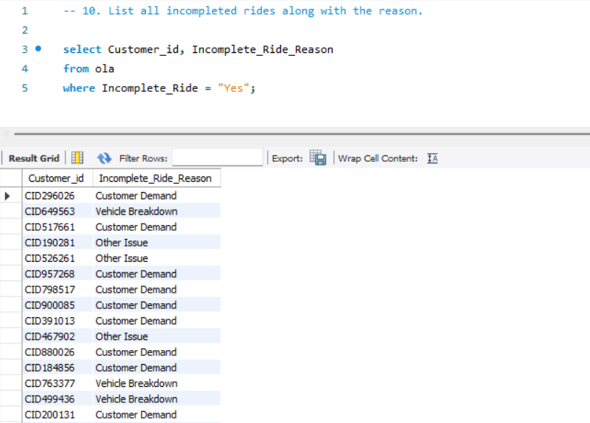
10. List all incomplete rides along with the reason
SQL Queries

